Slide 1

Demonstrations on cryptography
X
Caeser Cypher , Playfair Cypher and DES/Triple DES

Slide 2


TABLE OF CONTENTS
OBJECTIVES
Demonstration
01
02
DISCRETE MATH BEHIND IT
PSUEDO CODE
03
04
RV College of
Engineering
Go, change the world
X
To understand the purpose of the project
Demonstrating the project
In detail discussing the discrete math behind the project
Briefly discussing the psuedo code

Slide 3

01
OBJECTIVES
RV College of
Engineering
Go, change the world
Identifying the objectives of the project

Slide 4

INTRODUCTION
RV College of
Engineering
Go, change the world
Cryptography is a method of protecting information and communications through the use of codes, so that only those for whom the information is intended can read and process it.

Slide 5
-Jacob Appelbaum
RV College of
Engineering
Go, change the world
“One must acknowledge with cryptography (that) no amount of violence will ever solve a math problem.”

Slide 6
OBJECTIVES
RV College of
Engineering
Go, change the world
X
To Demonstrate caeser cypher , playfair cypher and DES using a fully fledged website made from scratch.
To Understand the discrete mathematics behind it so as to understand the purpose of the cryptographic cyphers.
Finally, complete the website , provide references and deploy in the internet for other people to refer.

Slide 7
02
DEMONstrations
RV College of
Engineering
Go, change the world
Live demonstrations of all the cyphers

Slide 8
03
MATH BEHIND!!!
RV College of
Engineering
Go, change the world
DISCRETE MATHS IN MENTIONED CYPHERS

Slide 9
CAESER CYPHER
RV College of
Engineering
Go, change the world

Slide 10
ENCRYPTION AND DECRPyption
RV College of
Engineering
Go, change the world
X
The Caesar Cipher technique is one of the earliest and simplest method of encryption technique. It’s simply a type of substitution cipher, i.e., each letter of a given text is replaced by a letter some fixed number of positions down the alphabet.
To Encrypt the given text x ,
E(X) = ( x + n ) % 26
Where n is the key and x is the cypher text
To Decrypt the given text x ,
D(X) = ( x - n ) % 26
Where n is the key and x is the encoded cypher text

Slide 11
AN EXAMPLE
RV College of
Engineering
Go, change the world
Encryption
X
Plain Text
Message:
Attack at Dawn
Cipher:
Caesar Cipher
Algorithm
Cipher Text
Message:
Dwwdfn Dw Gdyq
Decryption
Key (3)
Cipher Text
Message:
Dwwdfn Dw Gdyq
Cipher:
Caesar Cipher
Algorithm
Plain Text
Message:
Attack at Dawn
Key (3)

Slide 12

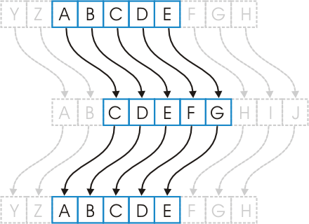
SHIFT OF 2 (key==2)
RV College of
Engineering
Go, change the world
X
(abcde +28) % 26
abcde +2
cdefg
(cdefg +28) % 26
cdefg +2
abcde

Slide 13
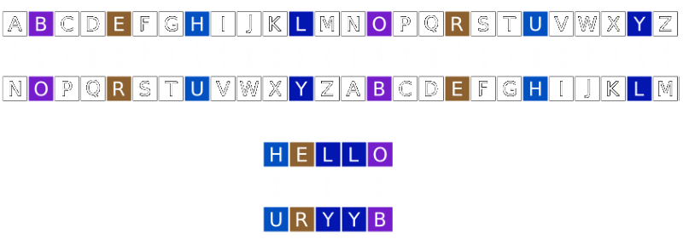
ROT 13- WHERE KEY==13
RV College of
Engineering
Go, change the world
X

Slide 14
Playfair CYPHER
RV College of
Engineering
Go, change the world

Slide 15

EXAMPLE
RV College of
Engineering
Go, change the world
X
1. Split the cypher text into groups of 2 using BOGUS LETTER WHEREVER NECESSARY
PlainText: "instruments"
Key: monarchy
After Split: 'in' 'st' 'ru' 'me' 'nt' 'sz’
Plain Text: “hello”
Key : monarchy
After Split: “he” “lx” “lo”
2. Generate key square is a 5×5 grid of alphabets that acts as the key for encrypting the plaintext. Each of the 25 alphabets must be unique and one letter of the alphabet (usually J) is omitted from the table (as the table can hold only 25 alphabets). If the plaintext contains J, then it is replaced by I.

Slide 16

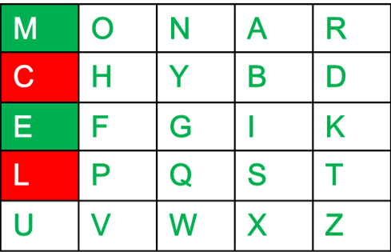
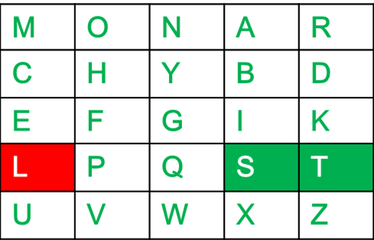
Example
RV College of
Engineering
Go, change the world
X
If both the letters are in the same column: Take the letter below each one
If both the letters are in the same row: Take the letter to the right of each one (going back to the leftmost if at the rightmost position).

Slide 17
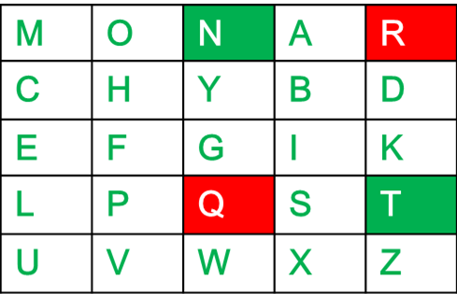
EXAMPLE
RV College of
Engineering
Go, change the world
X
If neither of the above rules is true: Form a rectangle with the two letters and take the letters on the horizontal opposite corner of the rectangle.
Plain Text: "instrumentsz"
Encrypted Text: gatlmzclrqtx
Encryption:
i -> g
n -> a
s -> t
t -> l
r -> m
u -> z
m -> c
e -> l
n -> r
t -> q
s -> t
z -> x

Slide 18
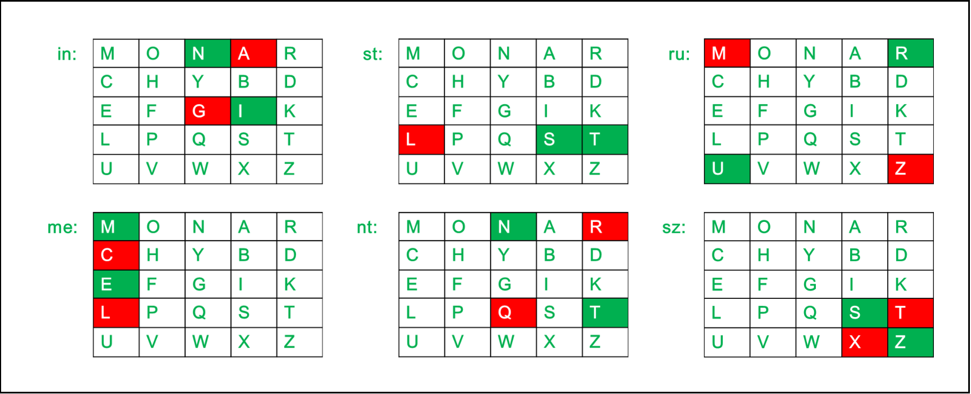
Example
RV College of
Engineering
Go, change the world
X

Slide 19
DECRYPTION
Go, change the world
RV College of
Engineering
X
If both the letters are in the same column: Take the letter above each one (going back to the bottom if at the top).
If both the letters are in the same row: Take the letter to the left of each one (going back to the rightmost if at the leftmost position).
If neither of the above rules is true: Form a rectangle with the two letters and take the letters on the horizontal opposite corner of the rectangle.
Plain Text: "gatlmzclrqtx"
Decrypted Text: instrumentsz
Decryption:
(red)-> (green)
ga -> in
tl -> st
mz -> ru
cl -> me
rq -> nt
tx -> sz

Slide 20

Des /Triple DES
RV College of
Engineering
Go, change the world

Slide 21
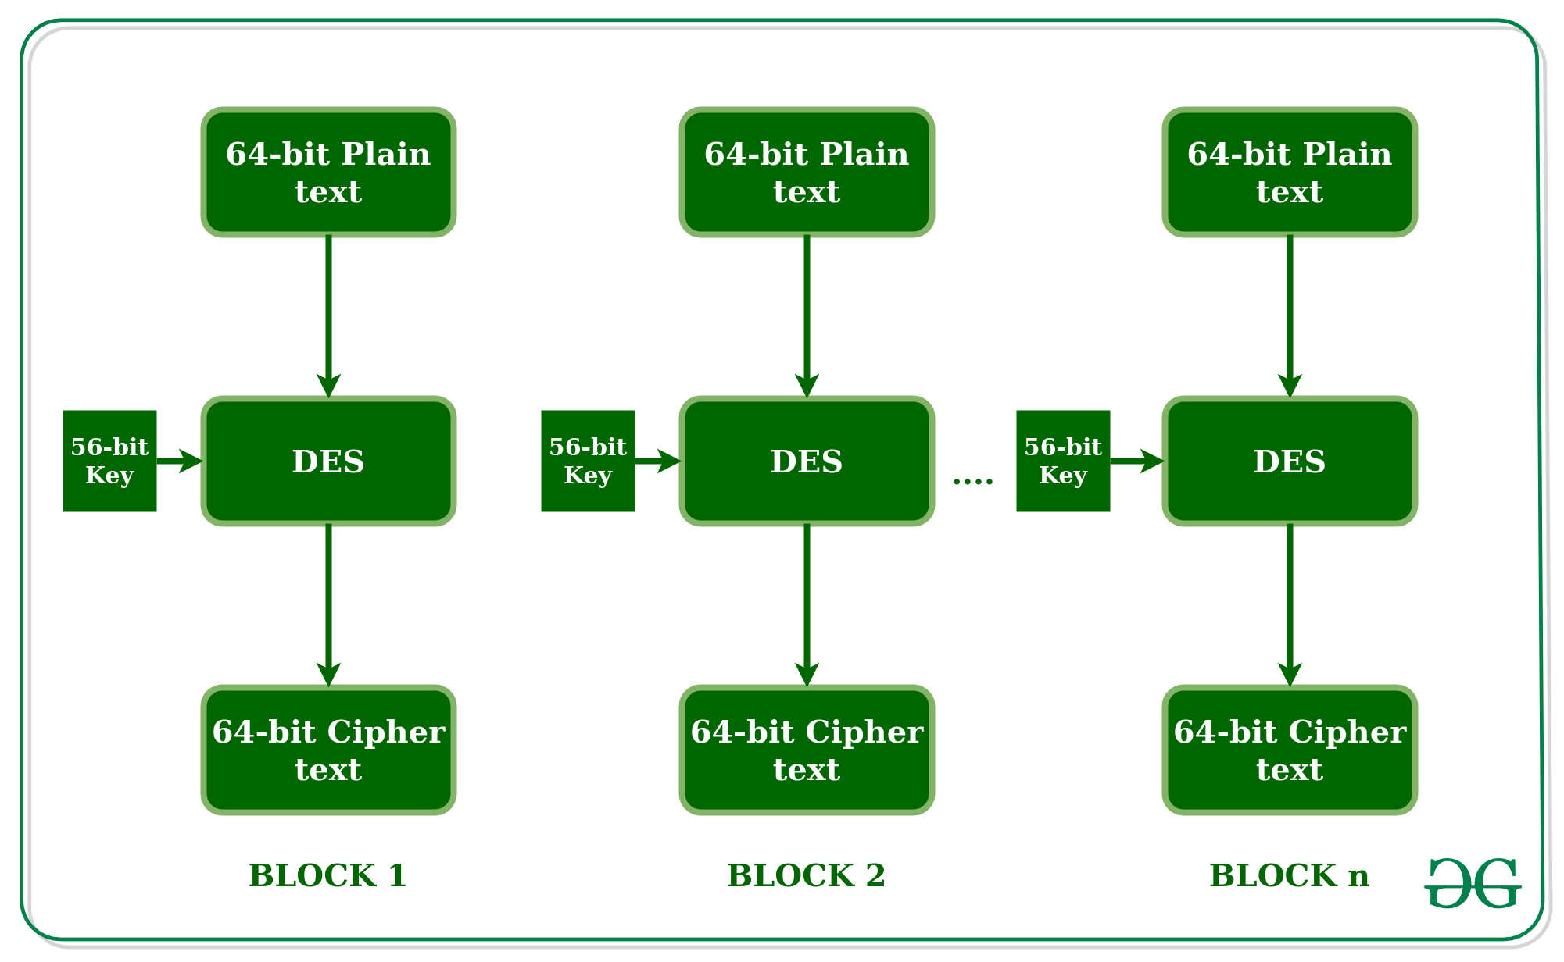
THeory
Go, change the world
RV College of
Engineering
X
DES is a block cipher and encrypts data in blocks of size of 64 bits each, which means 64 bits of plain text goes as the input to DES, which produces 64 bits of ciphertext.
The same algorithm and key are used for encryption and decryption, with minor differences. The key length is 56 bits. The basic idea is shown in the figure.

Slide 22
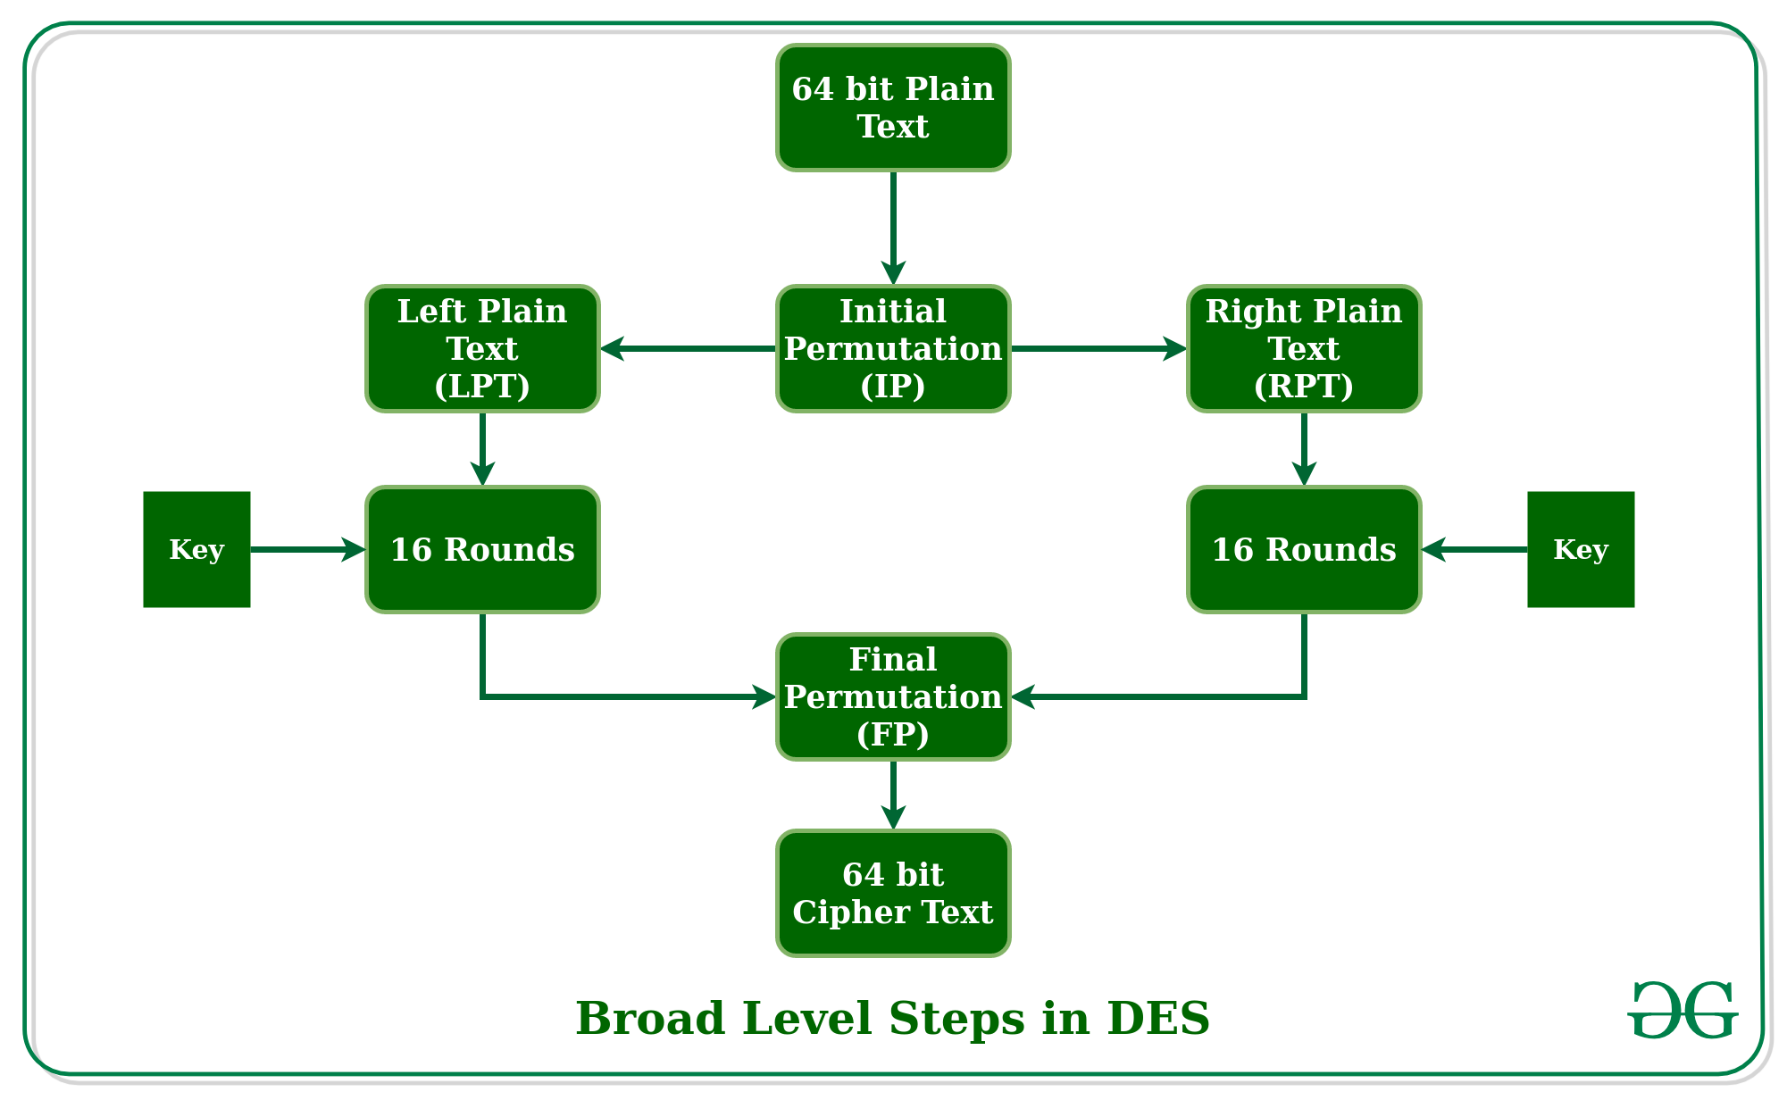
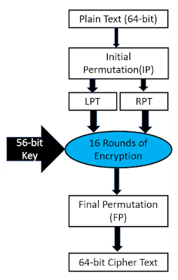
LEVEL DIAGRAM
RV College of
Engineering
Go, change the world
X
after IP is done, the resulting 64-bit permuted text block is divided into two half blocks(LPT AND RPT). Each half-block consists of 32 bits, and each of the 16 rounds, in turn, consists of the broad level steps outlined in the figure.

Slide 23
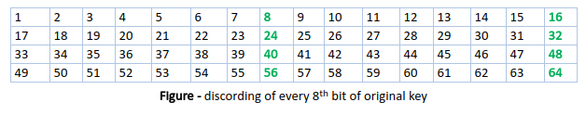
KEY DISCARDING
RV College of
Engineering
Go, change the world
X
Every 8th bit of the key is discarded to produce a 56-bit key.
If( bit_no % 8 == 0 ) { delete the bit }
DES is based on the two fundamental attributes of cryptography:
substitution (also called confusion)
transposition (also called diffusion)
DES consists of 16 steps, each of which is called a round. Each round performs the steps of substitution and transposition.

Slide 24
CONFUSION AND DIFFUSION
RV College of
Engineering
Go, change the world
X
Confusion
Confusion means that each binary digit (bit) of the ciphertext should depend on several parts of the key, obscuring the connections between the two.
The property of confusion hides the relationship between the ciphertext and the key.
Diffusion
Diffusion means that if we change a single bit of the plaintext, then about half of the bits in the ciphertext should change, and similarly, if we change one bit of the ciphertext, then about half of the plaintext bits should change. This is equivalent to the expectation that encryption schemes exhibit an avalanche effect.

Slide 25
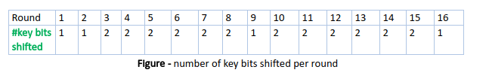
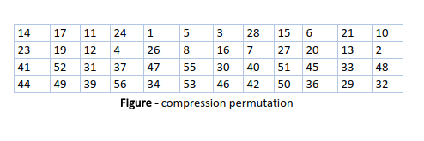
KEY
RV College of
Engineering
Go, change the world
X
1. Key transformation –
56-bit key is divided into two halves, each of 28 bits.
Halves are circularly shifted left by one or two positions, depending on the round.
48 of the 56 bits are selected by using compression table given below
56-bit key

Slide 26
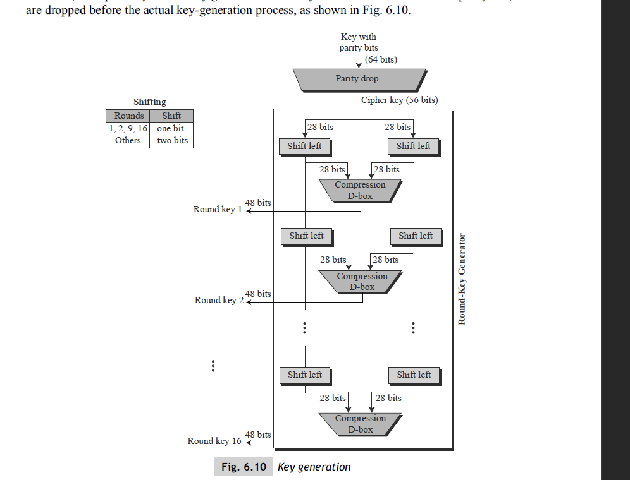
KEY
Go, change the world
RV College of
Engineering
Because of this compression permutation technique, a different subset of key bits is used in each round. That makes DES not easy to crack.

Slide 27
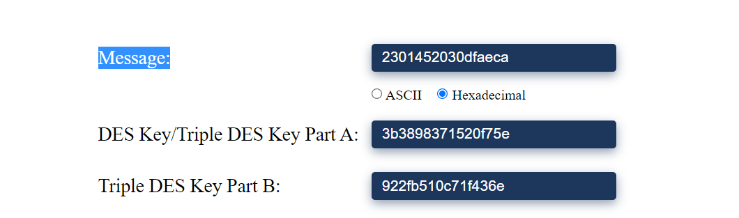
EXAMPLE
Go, change the world
RV College of
Engineering
Input bits: 00100011 00000001 01000101 00100000 00110000 11011111 10101110 11001010
Key bits: 00111011 00111000 10011000 00110111 00010101 00100000 11110111 01011110
Input key converted in Binary format. After Bit discarding and a small permutation->
CD[0] : 0100010 0110000 0001101 0111101 1100100 1110110 0010000 1111111
CD[1] : 1000100 1100000 0011010 1111010 1001001 1101100 0100001 1111111
KS[1] : 010111 000000 100001 001100 010101 011000 111101 001111 (key for round 1)
CD[0] -> Intial state KS[1] -> Using the compression table choosing the
CD[1] -> State after Shift of 1 Appropriate Bits

Slide 28
EXAMPLE
Go, change the world
RV College of
Engineering
Similarly for 16 Rounds we generate 16 keys
CD[2] : 0001001 1000000 0110101 1110101 0010011 1011000 1000011 1111111
KS[2] : 010100 010010 110111 110000 011001 001001 011111 001100
CD[3] : 0100110 0000001 1010111 1010100 1001110 1100010 0001111 1111100
KS[3] : 110101 001110 010010 000101 110110 001011 010011 101111
CD[4] : 0011000 0000110 1011110 1010001 0111011 0001000 0111111 1110010
KS[4] : 010100 111000 011100 000110 011011 101101 111010 101001
CD[5] : 1100000 0011010 1111010 1000100 1101100 0100001 1111111 1001001
KS[5] : 011010 001001 000010 100111 000110 100111 110101 111011
CD[6] : 0000000 1101011 1101010 0010011 0110001 0000111 1111110 0100111
KS[6] : 101100 011000 000001 101110 101011 111101 100100 110000
CD[7] : 0000011 0101111 0101000 1001100 1000100 0011111 1111001 0011101
KS[7] : 101000 000100 001010 110010 110000 010110 111101 110010
CD[8] : 0001101 0111101 0100010 0110000 0010000 1111111 1100100 1110110
KS[8] : 101101 000001 101100 110100 111111 011000 101000 011100
CD[9] : 0011010 1111010 1000100 1100000 0100001 1111111 1001001 1101100
KS[9] : 001000 101101 110101 000010 100100 111000 011001 111100
CD[10] : 1101011 1101010 0010011 0000000 0000111 1111110 0100111 0110001
KS[10] : 011010 000110 000101 010111 110110 011011 111110 000100
CD[11] : 0101111 0101000 1001100 0000011 0011111 1111001 0011101 1000100
KS[11] : 001001 011100 010100 011001 001110 000110 011010 111101
CD[12] : 0111101 0100010 0110000 0001101 1111111 1100100 1110110 0010000
KS[12] : 010001 110000 000110 110011 011110 110111 100010 000111
CD[13] : 1110101 0001001 1000000 0110101 1111111 0010011 1011000 1000011
KS[13] : 101111 111000 100010 010001 101001 100110 000110 111011
CD[14] : 1010100 0100110 0000001 1010111 1111100 1001110 1100010 0001111
KS[14] : 000111 110010 001010 001010 101001 110011 101101 000111
CD[15] : 1010001 0011000 0000110 1011110 1110010 0111011 0001000 0111111
KS[15] : 001110 100001 010010 011100 111101 101000 001111 110010
CD[16] : 0100010 0110000 0001101 0111101 1100100 1110110 0010000 1111111
KS[16] : 000100 010111 110010 000001 110101 111110 000101 001110

Slide 29
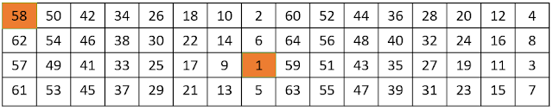
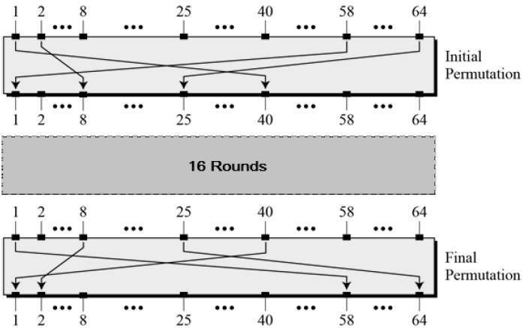
INTIAL AND FINAL PERMUTATION
Initial Permutation performed only once at the Beginning. Bit sequence have changed as per IP table.
For Example: 1st bit takes 40th Position, 58th bit take 1st position
Finally , after 16 rounds LPT and RPT are combined and they undergo final permutation to get the desired result

Slide 30
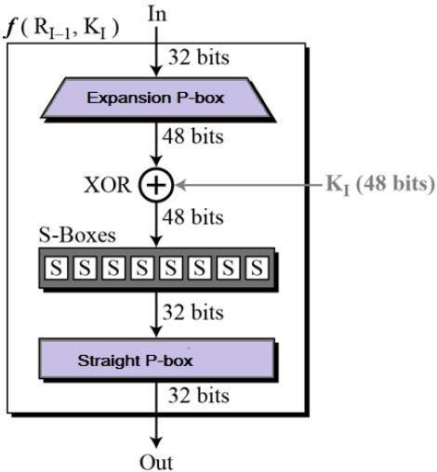
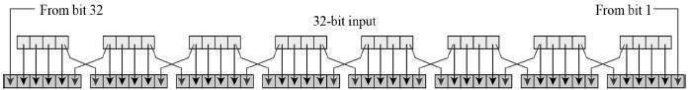
EXAPNSION P BOX
RV College of
Engineering
Go, change the world
X
Step-2 : Round Functions –
For a given round say round 1, we take RPT and it alternates every round( round 2 LPT is taken)
Since right input is 32-bit and round key is a 48-bit, we first need to expand right input to 48 bits.

Slide 31
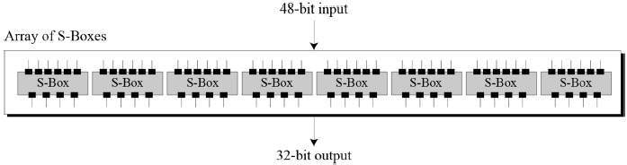
Example
RV College of
Engineering
Go, change the world
X
XOR (Whitener). − After the expansion permutation, DES does XOR operation on the expanded right section and the round key. The round key is used only in this operation.
Substitution Boxes. − The S-boxes carry out the real mixing (confusion). DES uses 8 S-boxes, each with a 6-bit input and a 4-bit output. Refer the following illustration −

Slide 32
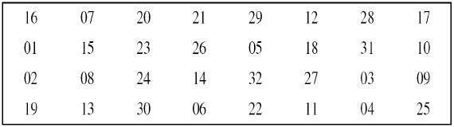
FINAL ROUND STRAIGHT PERMUTATION
RV College of
Engineering
Go, change the world
X
Straight Permutation − The 32 bit output of S-boxes is then subjected to the straight permutation with rule shown in the following illustration
The output from S-BOX is rearranged by following this table

Slide 33
COMING BACK TO EXAMPLE
RV College of
Engineering
Go, change the world
X
Input bits: 00100011 00000001 01000101 00100000 00110000 11011111 10101110 11001010
Key bits: 00111011 00111000 10011000 00110111 00010101 00100000 11110111 01011110
Key generated for each round
Key for [1] : 010111 000000 100001 001100 010101 011000 111101 001111
Input underges IP and Is split into
LPT and RPT
L[0]: 10100100 00110000 01100100 00100111
R[0]: 11100000 01011001 11100000 11100001

Slide 34
Round 1
Go, change the world
RV College of
Engineering
E is the LPT when it undergoes Expansion P-BOX Operation
Round 1
E : 111100 000000 001011 110011 111100 000001 011100 000011
KS : 010111 000000 100001 001100 010101 011000 111101 001111
Then the XOR Operation and S-BOX is carried out
Followed by straight permutation
E xor KS: 101011 000000 101010 111111 101001 011001 100001 001100
Sbox: 1001 1111 1111 1110 0001 0000 0110 1011
P : 01101100 11011011 01011101 01010110

Slide 35
Round 1
Go, change the world
RV College of
Engineering
For Convience we swap LPT And RPT for next round
L[0]: 10100100 00110000 01100100 00100111
R[0]: 11100000 01011001 11100000 11100001
L[i]: 11100000 01011001 11100000 11100001
R[i]: 11001000 11101011 00111001 01110001
Continue the same for all the rounds
Round 2
E : 111001 010001 011101 010110 100111 110010 101110 100011
KS : 010100 010010 110111 110000 011001 001001 011111 001100
E xor KS: 101101 000011 101010 100110 111110 111011 110001 101111
Sbox: 0001 1101 1111 0000 1110 0000 1001 1101
P : 00001111 00001101 01001001 10110111
L[i]: 11001000 11101011 00111001 01110001
R[i]: 11101111 01010100 10101001 01010110

Slide 36
RV College of
Engineering
Round 3
E : 011101 011110 101010 101001 010101 010010 101010 101101
KS : 110101 001110 010010 000101 110110 001011 010011 101111
E xor KS: 101000 010000 111000 101100 100011 011001 111001 000010
Sbox: 1101 1001 0101 0111 1000 0000 1110 0010
P : 10000101 11011011 11010100 00000011
L[i]: 11101111 01010100 10101001 01010110
R[i]: 01001101 00110000 11101101 01110010
Round 4
E : 001001 011010 100110 100001 011101 011010 101110 100100
KS : 010100 111000 011100 000110 011011 101101 111010 101001
E xor KS: 011101 100010 111010 100111 000110 110111 010100 001101
Sbox: 0011 1110 1010 0110 0001 0111 1001 0111
P : 01100010 01101010 00111011 00111111
L[i]: 01001101 00110000 11101101 01110010
R[i]: 10001101 00111110 10010010 01101001
Round 5
E : 110001 011010 100111 111101 010010 100100 001101 010011
KS : 011010 001001 000010 100111 000110 100111 110101 111011
E xor KS: 101011 010011 100101 011010 010100 000011 111000 101000
Sbox: 1001 0000 1101 1100 0011 1111 0000 1001
P : 00111100 10100001 00111001 11001010
L[i]: 10001101 00111110 10010010 01101001
R[i]: 01110001 10010001 11010100 10111000
Round 6
E : 001110 100011 110010 100011 111010 101001 010111 110000
KS : 101100 011000 000001 101110 101011 111101 100100 110000
E xor KS: 100010 111011 110011 001101 010001 010100 110011 000000
Sbox: 0001 0101 1111 0000 0101 0011 0101 1101
P : 00101110 00110101 01101001 00110110
L[i]: 01110001 10010001 11010100 10111000
R[i]: 10100011 00001011 11111011 01011111
Round 7
E : 110100 000110 100001 010111 111111 110110 101011 111111
KS : 101000 000100 001010 110010 110000 010110 111101 110010
E xor KS: 011100 000010 101011 100101 001111 100000 010110 001101
Sbox: 0000 0001 1001 0000 0001 1001 0111 0111
P : 00110110 00010010 01101101 00100000
L[i]: 10100011 00001011 11111011 01011111
R[i]: 01000111 10000011 10111001 10011000

Slide 37
Round 8
E : 001000 001111 110000 000111 110111 110011 110011 110000
KS : 101101 000001 101100 110100 111111 011000 101000 011100
E xor KS: 100101 001110 011100 110011 001000 101011 011011 101100
Sbox: 1000 0100 0010 0100 0111 0101 1111 1110
P : 00101010 10010110 00110100 10111101
L[i]: 01000111 10000011 10111001 10011000
R[i]: 10001001 10011101 11001111 11100010
Round 9
E : 010001 010011 110011 111011 111001 011111 111100 000101
KS : 001000 101101 110101 000010 100100 111000 011001 111100
E xor KS: 011001 111110 000110 111001 011101 100111 100101 111001
Sbox: 1001 1111 1110 1100 1000 1100 1101 0011
P : 01010011 10011011 01011001 01011111
L[i]: 10001001 10011101 11001111 11100010
R[i]: 00010100 00011000 11100000 11000111
Round 10
E : 100010 101000 000011 110001 011100 000001 011000 001110
KS : 011010 000110 000101 010111 110110 011011 111110 000100
E xor KS: 111000 101110 000110 100110 101010 011010 100110 001010
Sbox: 0011 0001 1110 0000 1101 0111 1101 1111
P : 00101011 00110111 01101011 00101111
L[i]: 00010100 00011000 11100000 11000111
R[i]: 10100010 10101010 10100100 11001101
Round 11
E : 110100 000101 010101 010101 010100 001001 011001 011011
KS : 001001 011100 010100 011001 001110 000110 011010 111101
E xor KS: 111101 011001 000001 001100 011010 001111 000011 100110
Sbox: 0110 0110 1101 1001 0000 0101 0000 0001
P : 11000100 00000001 10101011 01011000
L[i]: 10100010 10101010 10100100 11001101
R[i]: 11010000 00011001 01001011 10011111
RV College of
Engineering

Slide 38
Round 12
E : 111010 100000 000011 110010 101001 010111 110011 111111
KS : 010001 110000 000110 110011 011110 110111 100010 000111
E xor KS: 101011 010000 000101 000001 110111 100000 010001 111000
Sbox: 1001 1001 0000 1101 1001 1001 1110 1111
P : 10111001 10011010 01111100 01100011
L[i]: 11010000 00011001 01001011 10011111
R[i]: 00011011 00110000 11011000 10101110
Round 13
E : 000011 110110 100110 100001 011011 110001 010101 011100
KS : 101111 111000 100010 010001 101001 100110 000110 111011
E xor KS: 101100 001110 000100 110000 110010 010111 010011 100111
Sbox: 0010 0100 1001 1111 1001 1110 0011 0111
P : 10110111 01100010 00011111 01111000
L[i]: 00011011 00110000 11011000 10101110
R[i]: 01100111 01111011 01010100 11100111
Round 14
E : 101100 001110 101111 110110 101010 101001 011100 001110
KS : 000111 110010 001010 001010 101001 110011 101101 000111
E xor KS: 101011 111100 100101 111100 000011 011010 110001 001001
Sbox: 1001 0010 1101 1000 1011 0111 1001 1010
P : 01101111 10100011 00100001 11001011
L[i]: 01100111 01111011 01010100 11100111
R[i]: 01110100 10010011 11111001 01100101
Round 15
E : 101110 101001 010010 100111 111111 110010 101100 001010
KS : 001110 100001 010010 011100 111101 101000 001111 110010
E xor KS: 100000 001000 000000 111011 000010 011010 100011 111000
Sbox: 0100 0110 1010 0111 1100 0111 1011 1111
P : 11001011 01100110 10111101 00111101
L[i]: 01110100 10010011 11111001 01100101
R[i]: 10101100 00011101 11101001 11011010
Round 16
E : 010101 011000 000011 111011 111101 010011 111011 110101
KS : 000100 010111 110010 000001 110101 111110 000101 001110
E xor KS: 010001 001111 110001 111010 001000 101101 111110 111011
Sbox: 1010 1110 0100 0010 0111 1111 0010 0101
P : 01110000 11101101 00101110 10111000
L[i]: 10101100 00011101 11101001 11011010
R[i]: 00000100 01111110 11010111 11011101
RV College of
Engineering

Slide 39
FINAL PERMUTATION
Go, change the world
RV College of
Engineering
Output is generated in round 16
L[i]: 10101100 00011101 11101001 11011010
R[i]: 00000100 01111110 11010111 11011101
LPT and RPT are combined and finally the
Output is generated
LR[16] 00000100 01111110 11010111 11011101 10101100 00011101 11101001 11011010
Output 00101101 00010110 11110101 10111011 00110111 10011000 00011111 10001111

Slide 40
PRINCIPLE BEHIND S BOX
RV College of
Engineering
Go, change the world
0
1
2
3
.
.
.
.
.
.
.
44
45
46
47
6bit
sbox1
4bit
0
1
2
3
.
.
.
.
28
29
30
31
6bit
sbox2
4bit
6bit
sbox3
4bit
Input to p box
Permutation
6bit
sbox4
4bit
6bit
sbox5
4bit
6bit
sbox6
4bit
6bit
sbox7
4bit
6bit
sbox8
4bit
8 no of
6bit block
Sbox
48bit data

Slide 41
PRINCIPLE BEHIND S BOX
RV College of
Engineering
Go, change the world
1st bit | 2nd bit | 3rd bit | 4th bit | 5th bit | 6th bit
b1 | b2 | b3 | b4 | b5 | b6
b2 | b3 | b4 | b5
4bits Represent column no from (0)0000 to (15th)0000
b1 | b6
4bits Represent row no from (0)00 to (3)11 ie four row of s-box
Repeat for each s-box with each 6bit block

Slide 42
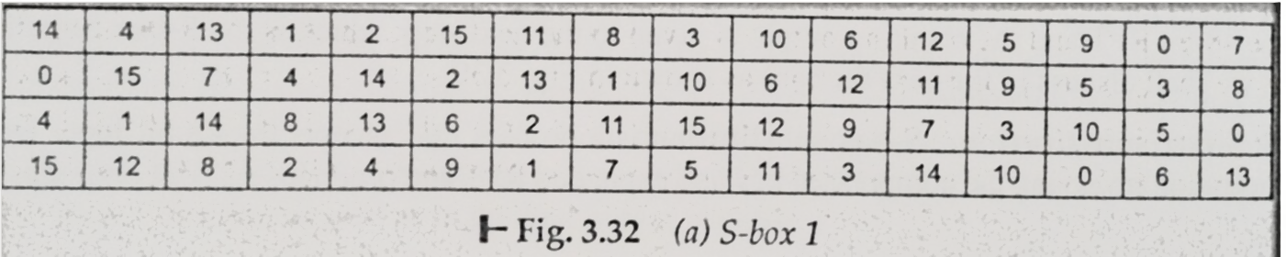
PRINCIPLE BEHIND S BOX
RV College of
Engineering
Go, change the world
0000
0001
CONSIDER THIS S – BOX TABLE FOR S-BOX 1
00
start counting row and column from 0
4 rows and 16 columns
Map the data in s-box located from row no bit b1b6 and column no bit b2b3b4b5
Consider 00 , 0001 which would be mapped and would give 4 -> 0100
Hence 000010 is converted into 0100

Slide 43
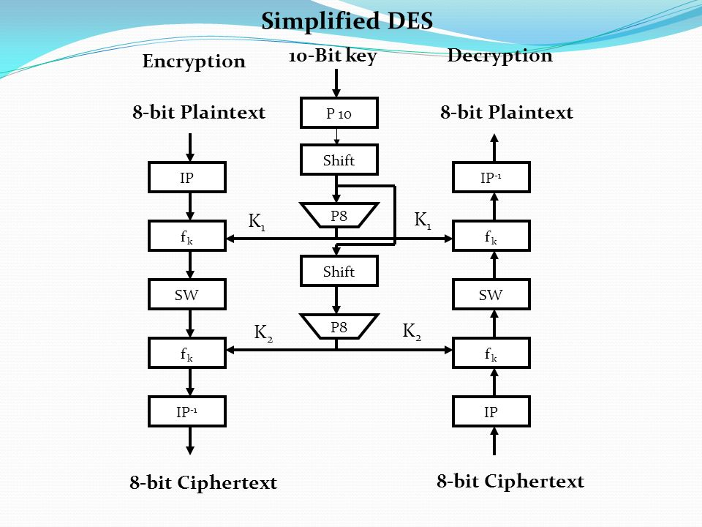
DECRYPTION DES
RV College of
Engineering
Go, change the world

Slide 44
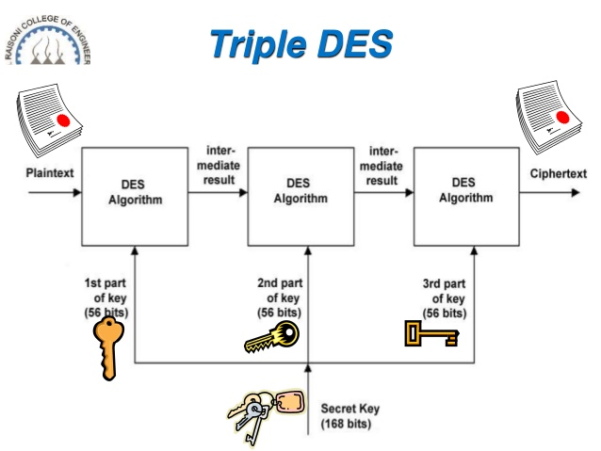
TRIPLE DES
RV College of
Engineering
Go, change the world

Slide 45
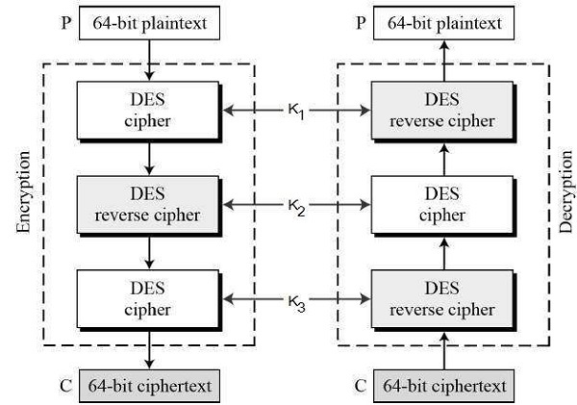
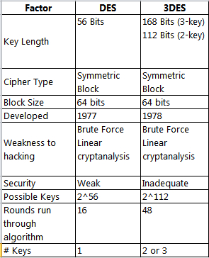
TRIPLE DES
RV College of
Engineering
Go, change the world

Slide 46
03.1
CODE IMPLEMENTATION
RV College of
Engineering
Go, change the world
Demo of code

Slide 47
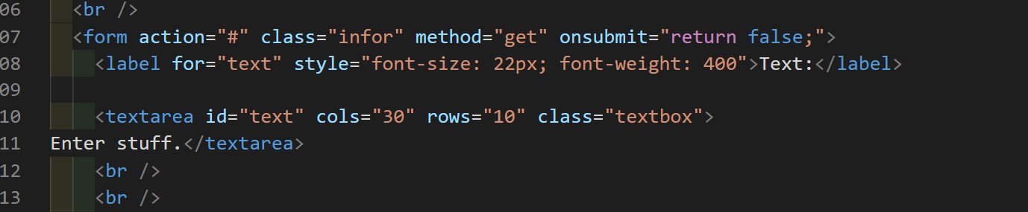
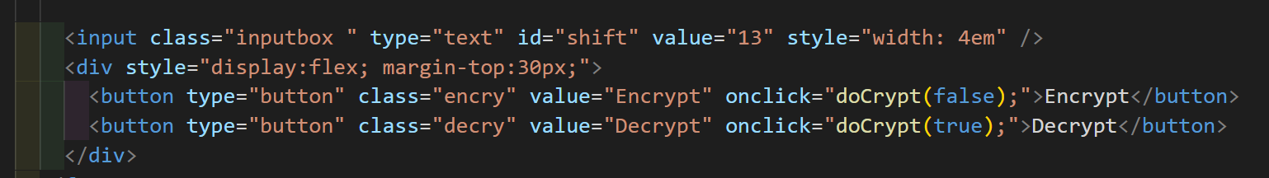
CODE IMPLEMENTATION
RV College of
Engineering
Go, change the world

Slide 48
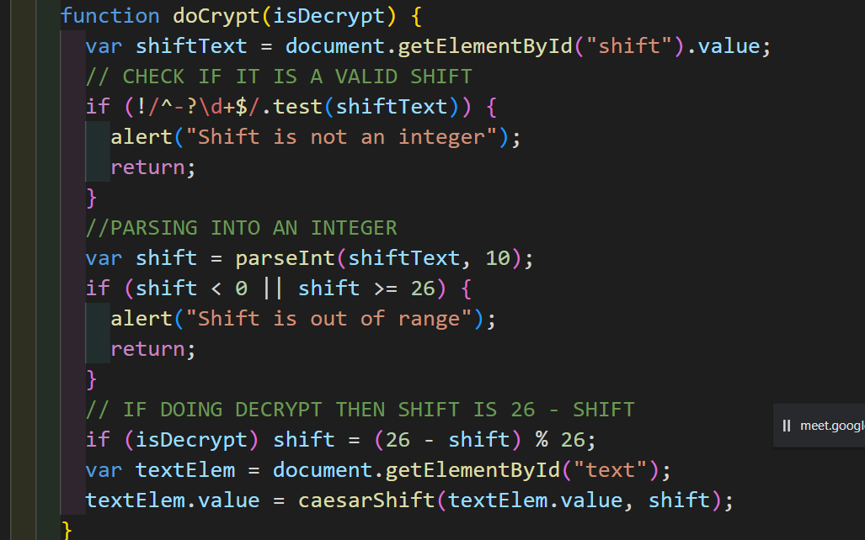
CODE IMPLEMENTATION
RV College of
Engineering
Go, change the world

Slide 49
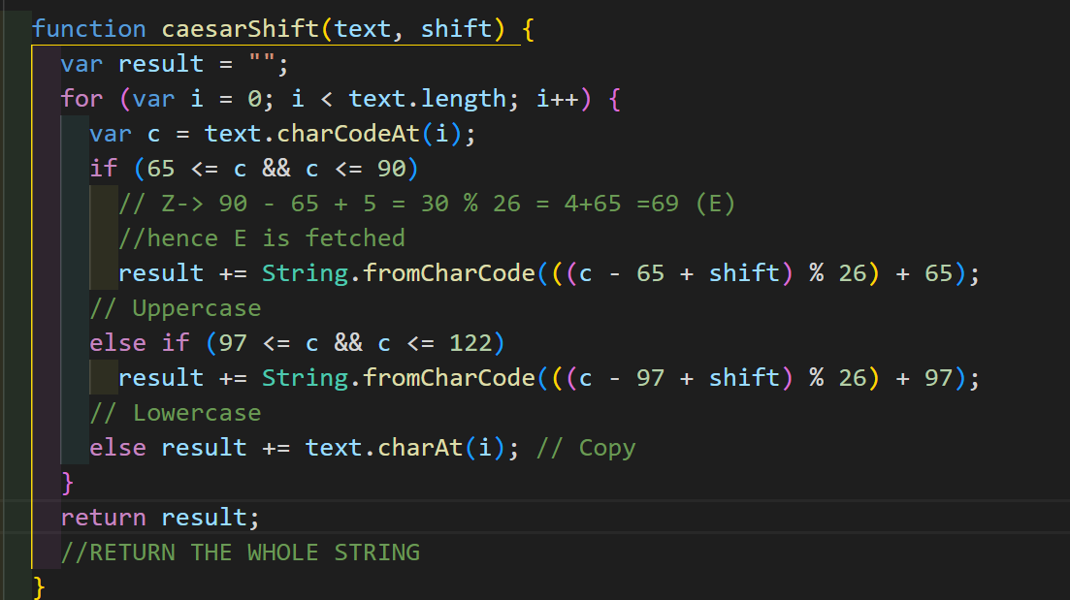
CODE IMPLEMENTATION
RV College of
Engineering
Go, change the world

Slide 50
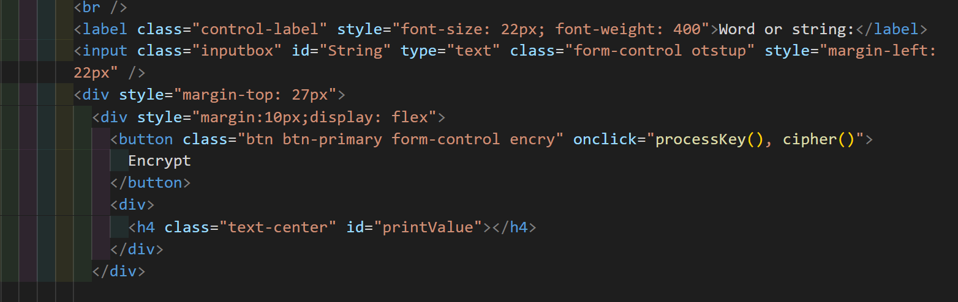
CODE IMPLEMENTATION
RV College of
Engineering
Go, change the world

Slide 51
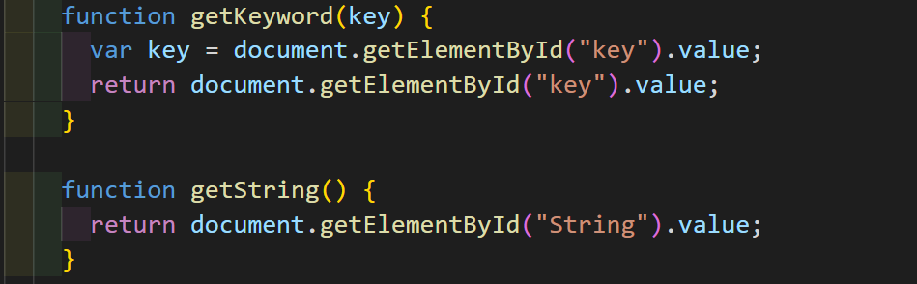
CODE IMPLEMENTATION
RV College of
Engineering
Go, change the world

Slide 52
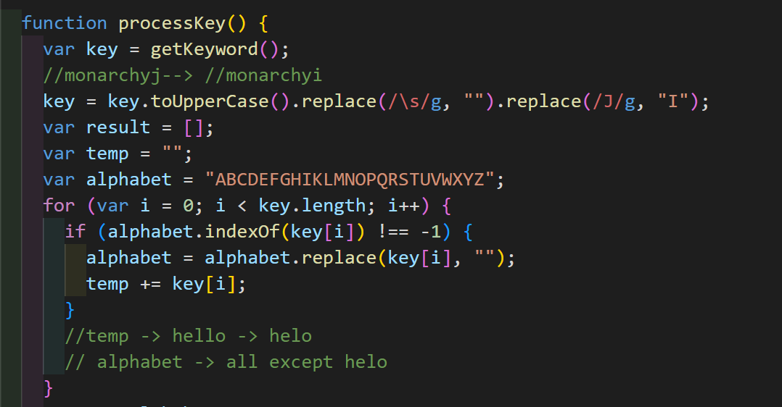
CODE IMPLEMENTATION
RV College of
Engineering
Go, change the world

Slide 53
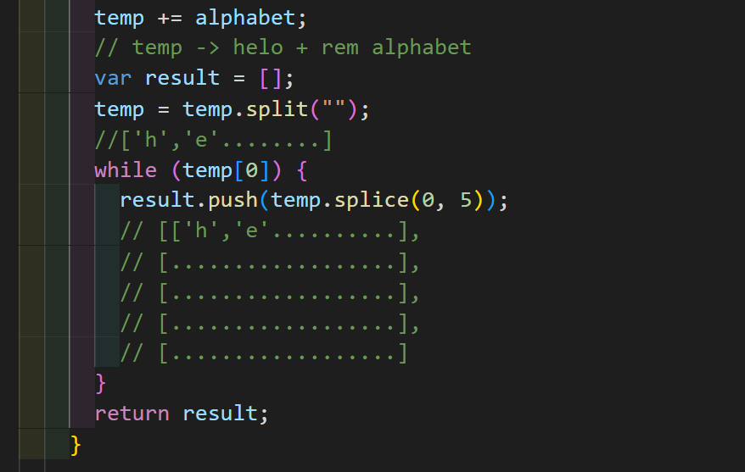
CODE IMPLEMENTATION
RV College of
Engineering
Go, change the world

Slide 54
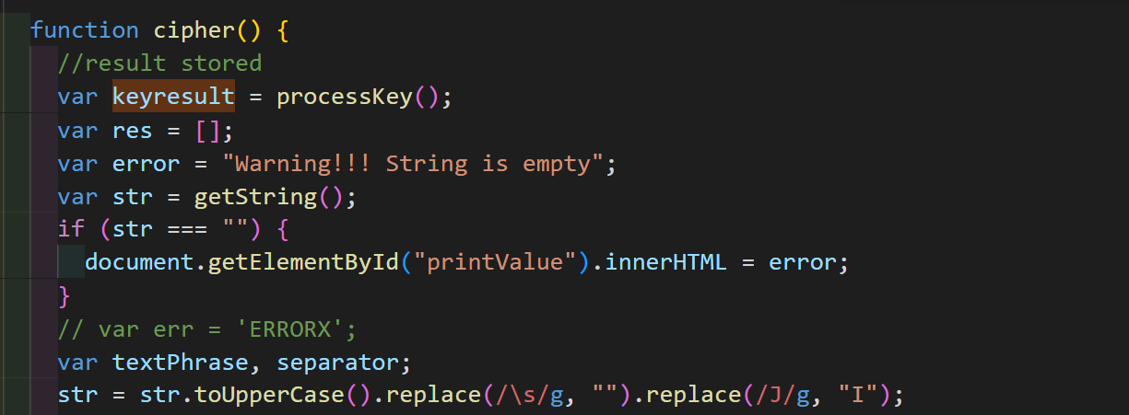
CODE IMPLEMENTATION
RV College of
Engineering
Go, change the world

Slide 55
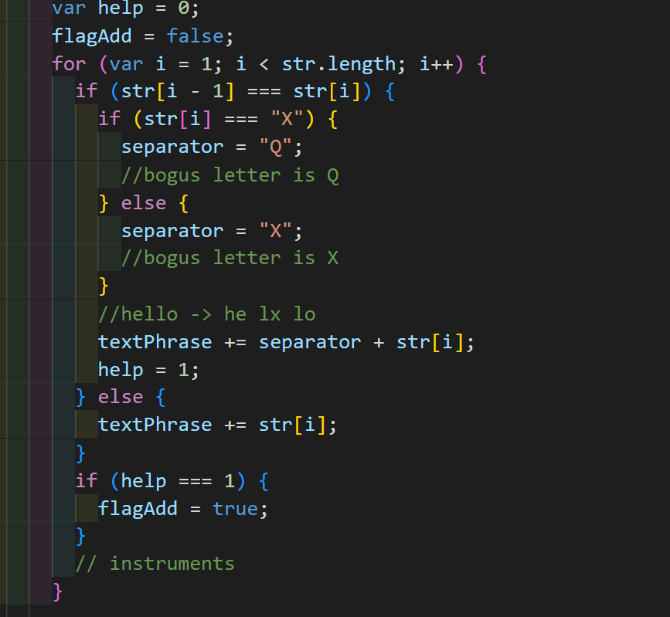
CODE IMPLEMENTATION
RV College of
Engineering
Go, change the world

Slide 56
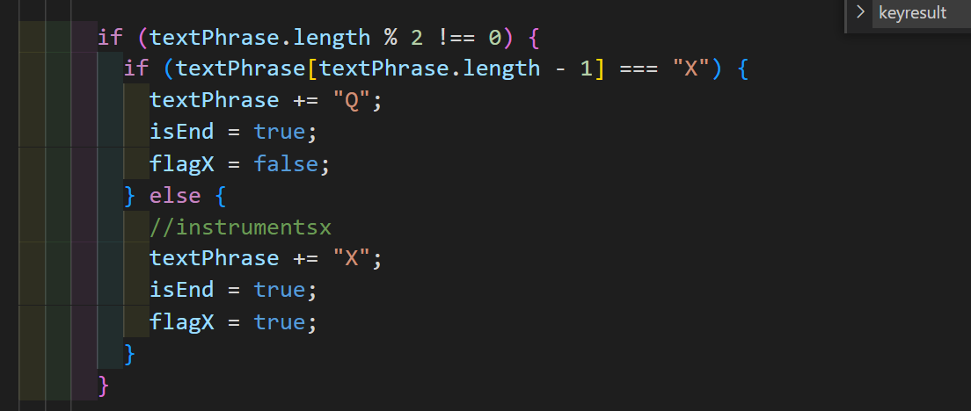
CODE IMPLEMENTATION
RV College of
Engineering
Go, change the world

Slide 57
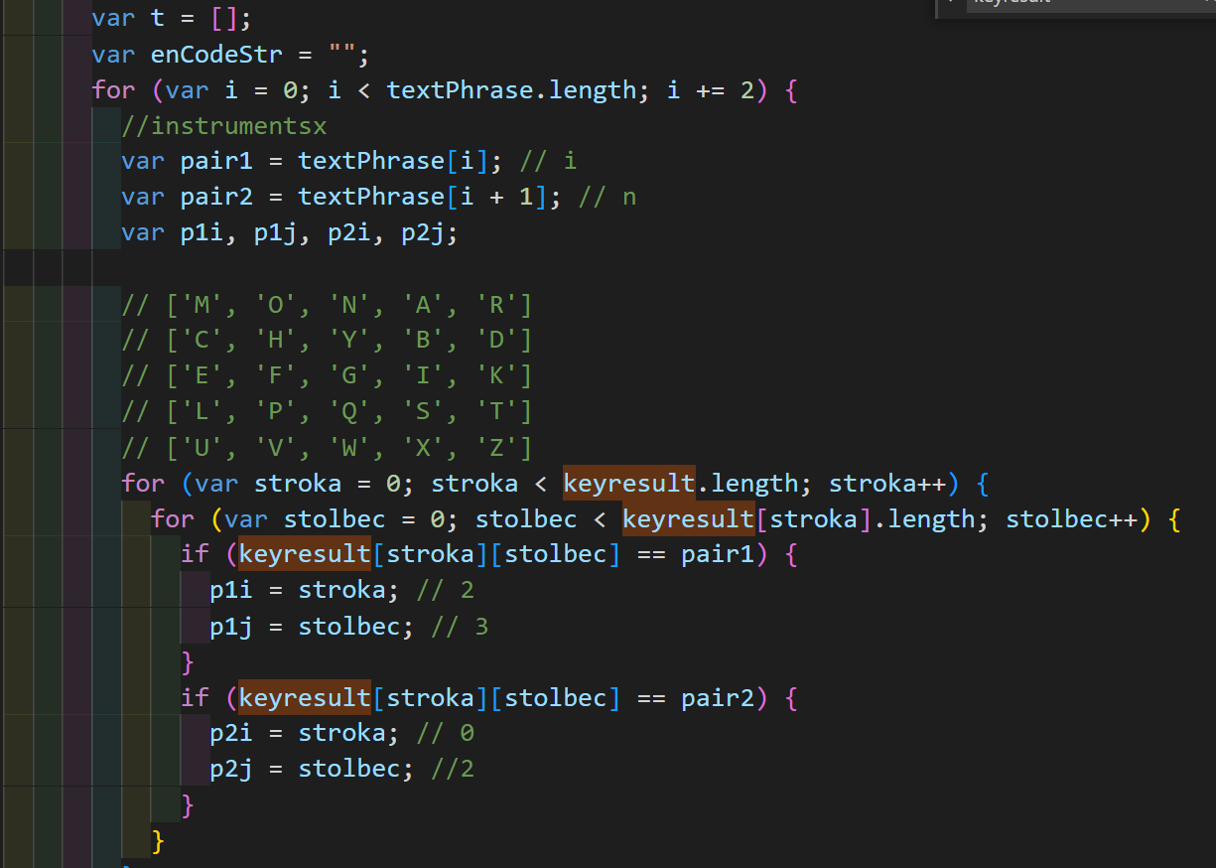
CODE IMPLEMENTATION
RV College of
Engineering
Go, change the world

Slide 58
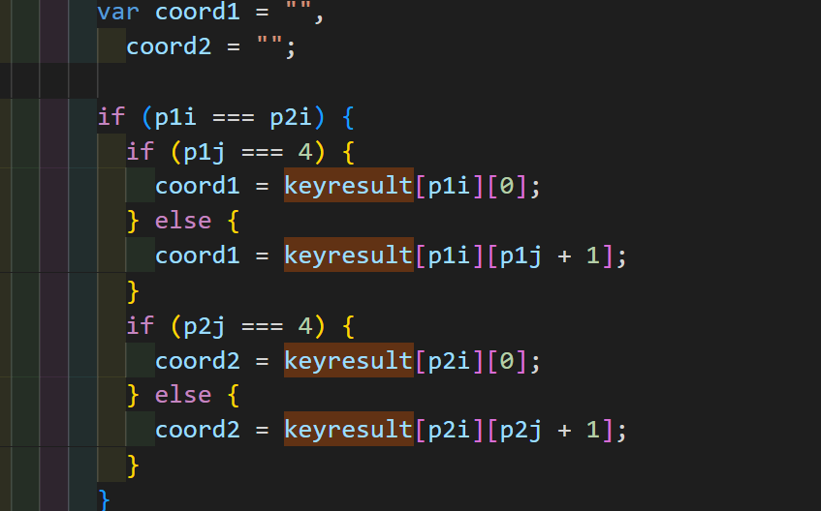
CODE IMPLEMENTATION
RV College of
Engineering
Go, change the world

Slide 59
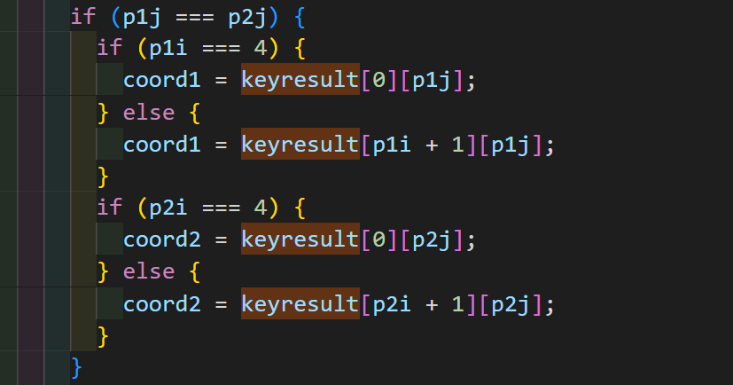
CODE IMPLEMENTATION
RV College of
Engineering
Go, change the world

Slide 60
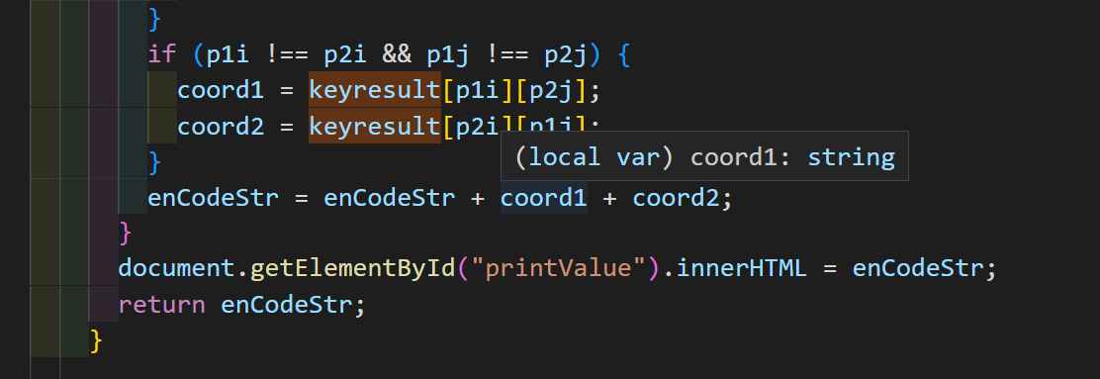
CODE IMPLEMENTATION
RV College of
Engineering
Go, change the world

Slide 61
04
REFERENCES AND CONCLUSION
RV College of
Engineering
Go, change the world
References and Conclusion

Slide 62
Conclusion
RV College of
Engineering
Go, change the world
Hence all the 3 cyphers/ encryption standard were presented which ranged from cyphers as simple as Caesar to as complex as DES.
But it turns out that all of the three cyphers are not secure and are hence crack able
CAESER CYPHER
Substitution ciphers are vulnerable to either word-pattern analysis, letter-frequency analysis, or some combination of both.
U can always look for the most common words in the given encoded cypher text
At the same time, there are only 25 combinations to try out and it can be done even manually and Hence , easily we can decrypt it.
ROT 13 is even simpler with only 1 possible combination involved.

Slide 63
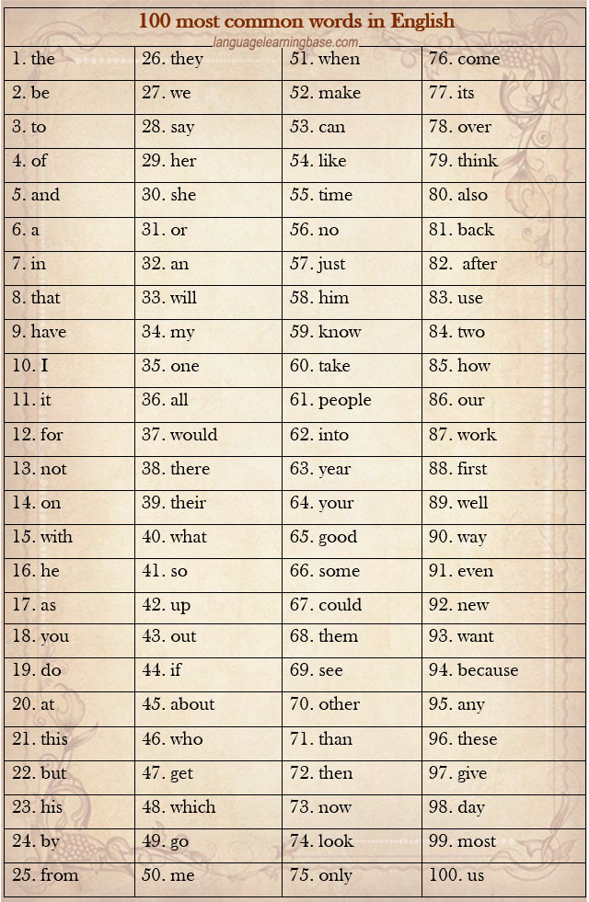
Conclusion
RV College of
Engineering
Go, change the world
Letter | Frequency
E | 130
T | 93
N | 78
R | 77
I | 74
O | 74
A | 73
S | 63
D | 44
H | 35
L | 35

Slide 64
Conclusion
RV College of
Engineering
Go, change the world
Playfair cipher can easily be cracked if a considerable amount of text is given by comparing with the frequencies of English alphabets, even though not as easy as Caesar and Vigenère cipher.
Ciphering methods should provide confusion and diffusion for them to be successful where as Playfair only provides confusion.
diffusion – drive away statistical structure of plaintext over bulk of ciphertext. Using some rigorous statistical methods we can crack Playfair easily.
confusion – makes relationship between ciphertext and key as complex as possible which Playfair does provide

Slide 65
Conclusion
RV College of
Engineering
Go, change the world
In the current standard and scenario, even DES is not secure enough. It was cracked in 1998 when a DES cracking machine was made
While no major flaws in its innards are known, it is fundamentally inadequate because its 56-bit key is too short. It is vulnerable to brute-force search of the whole key space.
Of course this also applies to any other cipher with only a 56-bit key.
Hence we observe due to mainly the modern computing power none of the cyphers are secure

Slide 66
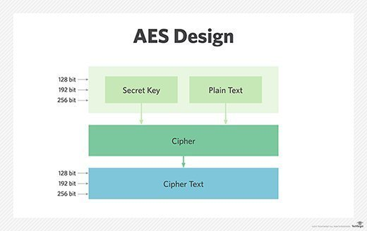
A SOLUTION - AES
RV College of
Engineering
Go, change the world
AES is a symmetric key cipher. This means the same secret key is used for both encryption and decryption, and both the sender and receiver of the data need a copy of the key.
The main difference is that AES uses 256 bit key whereas DES used 64 bit key which would make AES much more secure
We can also use Asymmetric key Encryption like RSA or ECDSA.

Slide 67
RESOURCES
RV College of
Engineering
Go, change the world
Theory
Playfair Theory
DES Theory
Caeser Theory
Videos
Playfair Video
DES Video

Slide 68
THANKS
RV College of
Engineering
Go, change the world
Made by:-
Mayur A
Karthik H
Mayur S
Maya R

